Slide 1


Face-O-Detect
Automated Image processing
Deciphering the Science of Data

Slide 2

ABOUT
US
SkyBits Technologies, is an Artificial Intelligence software development firm providing solutions and products to
various global clients. It was founded by the veterans of the IT industry with immense global experience. The core focus areas for SkyBits are Image Processing and Natural Language Processing (NLP) based on strong foundations in Deep
Learning technologies.

Slide 3
Management Team and Founders
Debabrata Dutta, Founder and Executive Director
Industry Experience: 30 Years
Past Organizations: DRDO, Wipro, Lucent, Ushacomm
Expertise: Machine Learning, Telecom, Parallel Computing,, Mobility
Education: M Tech Computer Sc. IISc Bangalore; B Tech Computer Sc. IIT Kharagpur
Satyajit Roy - Head of International Business Development
Industry Experience: 4 Years
Past Organizations: DNV, Go Marine, Early Stage Start-ups
Expertise: Technology Evaluation, Data analytics, management systems, Business Development, Six Sigma Black Belt
Education: Electrical Engineering and Economics from Pennsylvania State University
Ambar Mukerji, Executive Director
Industry Experience: 32 Years
Past Organizations: Lovelock/Flakt/Digital (DEC), Xerox, Telstra, UshaComm and early stage companies as CFO/COO/CEO.
Expertise: Financial and Business Management and Business Development and Financing
Education: Chartered Accountant

Slide 4
Tirthankar Banerjee – Advisor
Industry Experience: 30 Years
Past Orgs: Digital, Compaq, Sun, HCL Tech, HP
Expertise: Business Management, Machine Learning
Education: PGDM Marketing IMT; B Tech E&ECE IIT Kharagpur
Capt. Soumitro Roy - Advisor
Sujan Sinha – Advisor
Industry Experience: 40 Years
Past Orgs: Mobil, SCI, Reliance Industries, KOTC, ADNOC
Expertise: Commercial and operational Management of ships, Ani Piracy, Maritime training, Maritime software
Education: St Xavier's Kolkata, Master Mariner
Industry Experience: 37+ years
Past Organisations: SBI, Usha Martin Finance, Axis Bank, Shriram Housing Finance
Expertise: Retail Banking, Consumer Lending, Mortgages
Education: Presidency College, Kolkata
Nirendu Konar – Advisor
Industry Experience: 30 Years
Past Orgs: CISCO, SAIL, Wipro, Mastech, IBS
Expertise: Machine Learning, Deep learning, Business Analytics
Education: M Tech IIT Kharagpur, MBA University of Phoenix

Slide 5







Solutions and Technologies – Key Areas
Deep Learning
Statistical Analysis
Mobile Computing
and eLearning
Natural Language Processing
Image Processing

Slide 6






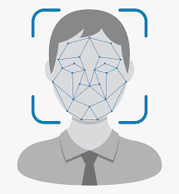



IMPLEMENTED SOLUTIONS
.
Prediction Modelling
CV Classification
E-KYC
Email and
Document
Classifier
Vehicle
Recognition
Social feed
Classifier
Chat Bot
Multi-Lingual Chat
Face Recognition
Drones

Slide 7
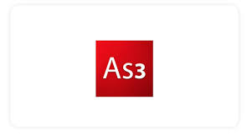












Technology Stack
MOBILE TECHNOLOGY
NEAR REAL TIME ANALYTICS
MACHINE LEARNING
Generic/ Cloud

Slide 8
Image Processing and
Computer Vision technologies
Online/Offline System
Face-O-Detect
Automated object detection and
recognition based monitoring system
Keeps the data in local server

Slide 9



Features
Voice Recognition
Tracking movement of a person
Crowd or body recognition
Face recognition & Sentiment Analysis
Eye Ball Tracking

Slide 10
Uses Of Face-O-Detect
Security surveillance of any office premises
Facial detection for ATM transaction
Attendance recording system
Traffic Management system
Can detect PPE compliance in factories

Slide 11
Technologies of Face-O-Detect
Face Detection
Face Recognition
Human Body Detection

Slide 12







OPTION 1: CAMERA BASED
Employee Enters
the hospital and
stands near a designated camera
Yellow: Analyzing face
Green: Face Recognized
Data sent to Skybits
System

Slide 13



OPTION 2: PERSONAL MOBILE APP
Hospital Wifi Network
Face-O-Detect
mobile App
Video or Selfie
taken
Data sent to cloud
API integration with
Client HRM software

Slide 14

OPTION 3: TABLET BASED
Face-O-Detect on Tab
Employee Stands
infron the tablet
Data sent to cloud
API integration with Client’s HRM
software

Slide 15






Our Clients

Slide 16
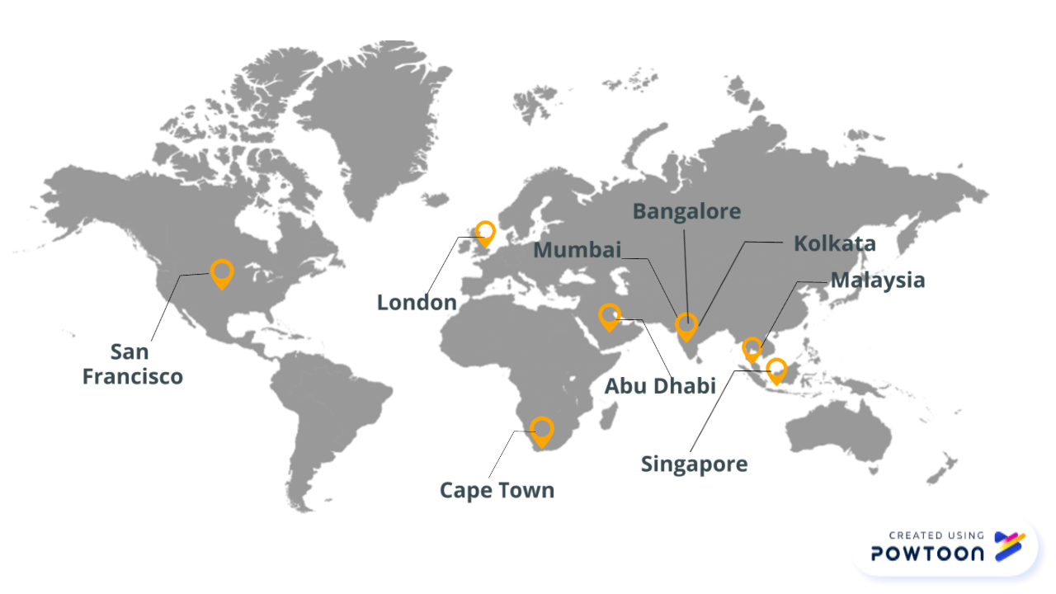
Locations

Slide 17
Contact us
+91-33-4000-3881
info@sky-bits.com
1416 DLF Galleria, Action Area 1B, New Town, Kolkata 700156, India
Visit us : http://sky-bits.com/

